Slide 1


PREDICTING INJURY SEVERITY IN MOTOR VEHICLE CRASHES USING CRSS DATA
By:
Srivarshika Gadde
Rishi Padala
Carter Lye
Sadika Kopparthi

Slide 2





MEET THE TEAM
Carter Lye
Srivarshika Gadde
Rishi Padala
Sadika Kopparthi

Slide 3


EXECUTIVE SUMMARY
Goal: Predict crash injury severity (Minor vs Major) using CRSS dataset to support traffic safety decisions.
Data: Cleaned, selected 31 key features, engineered new variables, balanced classes.
Models: Built and compared six models (Logistic Regression, Decision Tree, GBT, Random Forest, KNN, MLP) in KNIME.
Best Model: Gradient Boosted Trees (AUC 0.791), Random Forest (AUC 0.780) selected for deployment due to performance and interpretability.
Key Predictors: Restraint Use, Manner of Collision, Ejection Status, Alcohol Use Harmful Event, Over-speeding.

Slide 4
CRISP-DM PROCESS OVERVIEW
Business Understanding: Predict injury severity to guide safety interventions and planning.
Data Understanding: Integrated crash, vehicle, and person data; identified key predictors.
Data Preparation: Cleaned, engineered features, handled missing values, balanced dataset.
Modeling: Trained six ML models; tuned and evaluated with cross-validation.
Evaluation: Compared models using accuracy, sensitivity, specificity, and AUC.
Deployment: Selected Random Forest for production; built scoring and monitoring pipeline.

Slide 5
Business Understanding
Problem: Vehicle crashes cause major injuries and fatalities; predicting severity can save lives.
Objective: Build a model to predict if crash injuries are Minor or Major using CRSS data.
Impact: Help policymakers, traffic planners, and insurance companies make data-driven decisions.

Slide 6
Data Understanding
Source
Crash Report Sampling System (CRSS) — U.S. national crash database.
Data Table
Accident: Crash-level information (e.g., location, time, weather).
Vehicle: Vehicle-related details (e.g., type, speed, deformation).
Person: Occupant details (e.g., age, restraint use, injury severity).
Distracted: Driver distraction information.

Slide 7
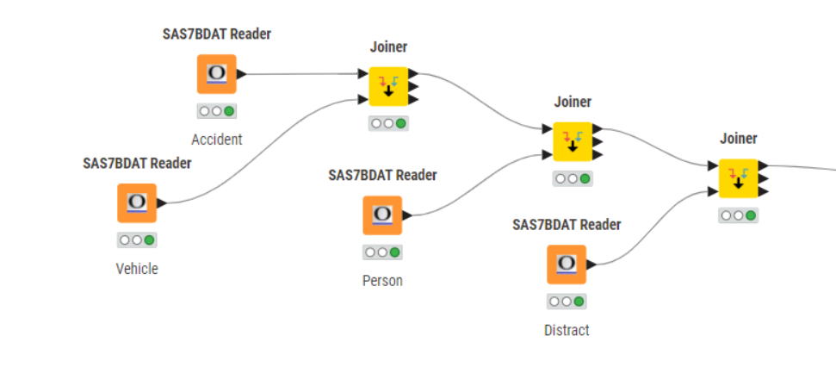
Data Integration Plan
Joining Strategy: Join the four tables using composite Keys:
CASE_NO (Crash ID)
VEH_NO (Vehicle ID)
Result: A unified dataset at the crash-participant level, combining crash, vehicle, and person information for each incident.

Slide 8
Understanding Raw Data
Categorical Variables Encoded as Numbers: Many fields (e.g., LGT_COND, DAY_WEEK, WEATHER) are stored as numeric codes.
Decode numeric values into meaningful labels using the CRSS User Manual.
Example mappings:
1 → "Daylight“
2 → "Dusk"

Slide 9
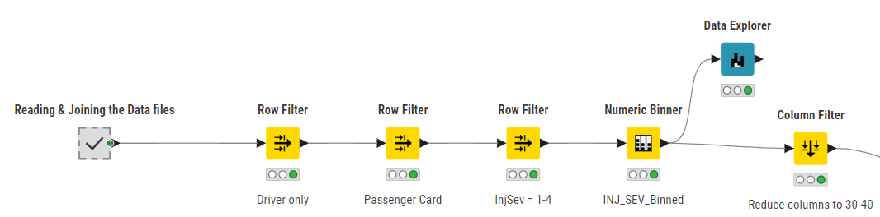
Data Preparation - Data Transformation Workflow
Initial Step: Using the unified data set.
First, filtered rows and kept only driver-related data, then filtered and kept only passenger cars.
Target Variable: Binned injury severity into Minor vs Major for prediction.
Why 31 Columns Were Selected:
Out of 205 variables, we selected 31 based on their strong relevance and correlation to injury severity, focusing on driver behavior, vehicle factors, and crash environment.
This selection is further supported later by the Random Forest variable importance chart.

Slide 10
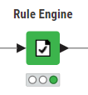
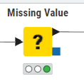
Handling Missing Data
Missing Value Indicators:
Placeholder codes like 9, 99, 999 and so on represent missing or unknown data.
Used the Rule Engine to handle unknown and not reported values, and to convert numeric variables into categorical groups
Applied the Missing Value node to impute missing entries using mean, median, or string values depending on the data type.

Slide 11
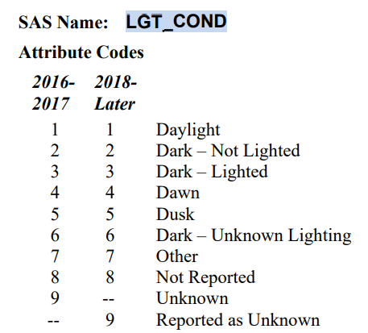

Feature Grouping for Simplified Categories
Simplified categorical features by grouping them into broader, more meaningful categories.
Example:
Daylight Includes crashes under full daylight (Code 1).
Dark Groups together crashes in dark conditions whether streets are lighted or not (Codes 2, 3, 6).
Dusk/Dawn Combines transitional lighting periods like dawn and dusk (Codes 4, 5).

Slide 12
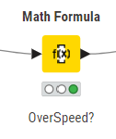
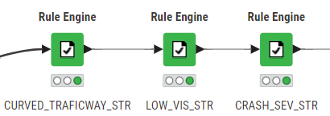
Feature Engineering
New Feature Creation:
Created new features and transformed existing variables to improve model performance using Math Formula and Rule Engine nodes.
Example:

Slide 13
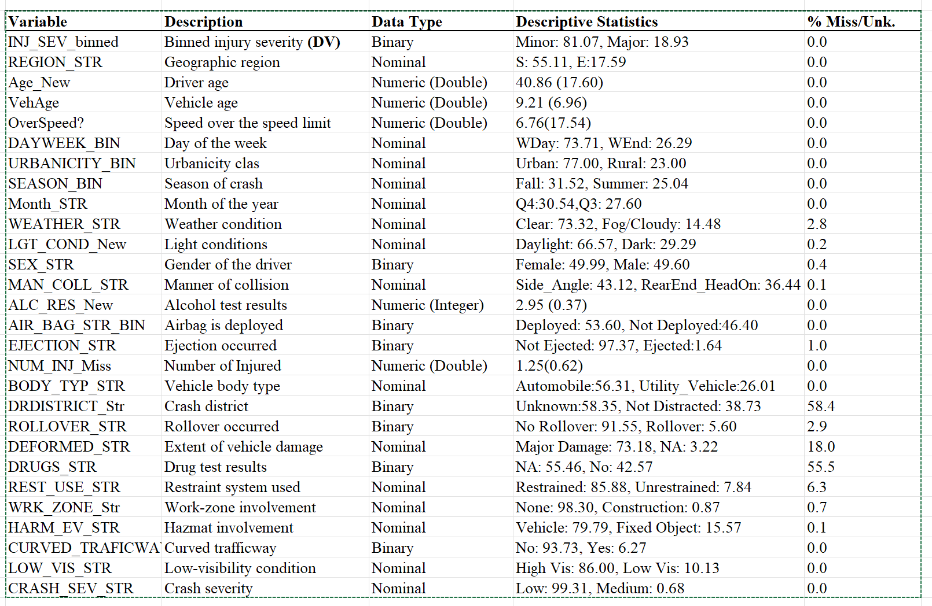
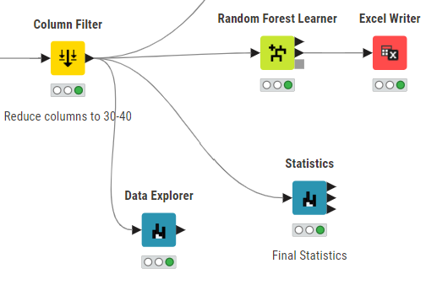
Final Formatting and Selection
Variable Selection: Used Column Filter node to select the handled data columns and Derived variables 28 columns.

Slide 14
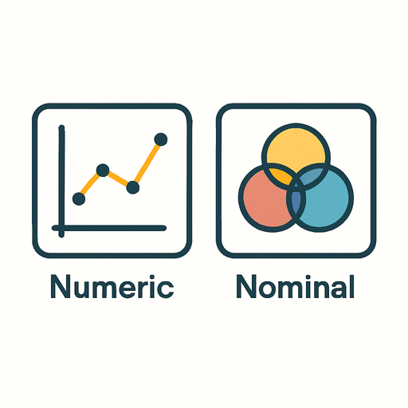
MODELING OVERVIEW
Developed and compared machine learning models to predict injury severity.
Nominal Models
Numeric Models
Decision Tree
Gradient Boosted Trees (GBT)
Random Forest
Logistic Regression
K-Nearest Neighbor (KNN)
Multi-Layer Perceptron (MLP)

Slide 15
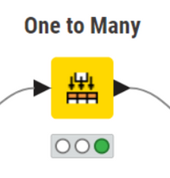
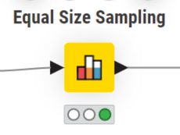
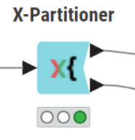
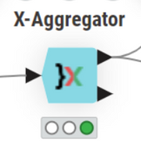
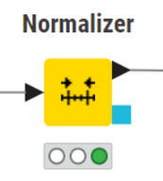
MODELING APPROACH
Data Handling Before Modeling:
One-to-Many Encoding
Equal Size Sampling
Converts categorical variables into numeric dummy variables using one-hot encoding.
Balances the dataset by sampling equal numbers of each class to address class imbalance.
X-Partitioner and X-Aggregator
Normalizer
Perform cross-validation by partitioning data into training/testing sets (X-Partitioner) and then combining results (X-Aggregator).
Scales numeric features into a standard range (e.g., 0–1) to improve model performance.

Slide 16
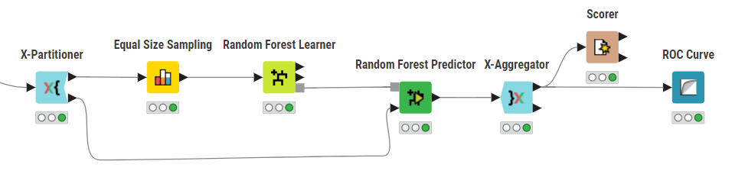
MODELING APPROACH
Random Forest

Slide 17
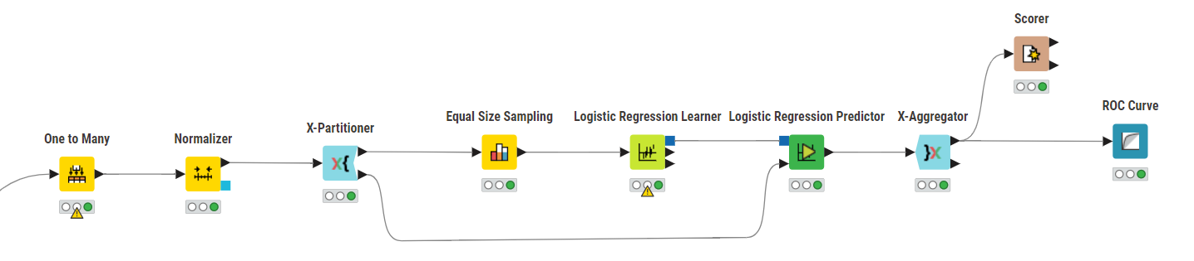
MODELING APPROACH
Logistic regression

Slide 18
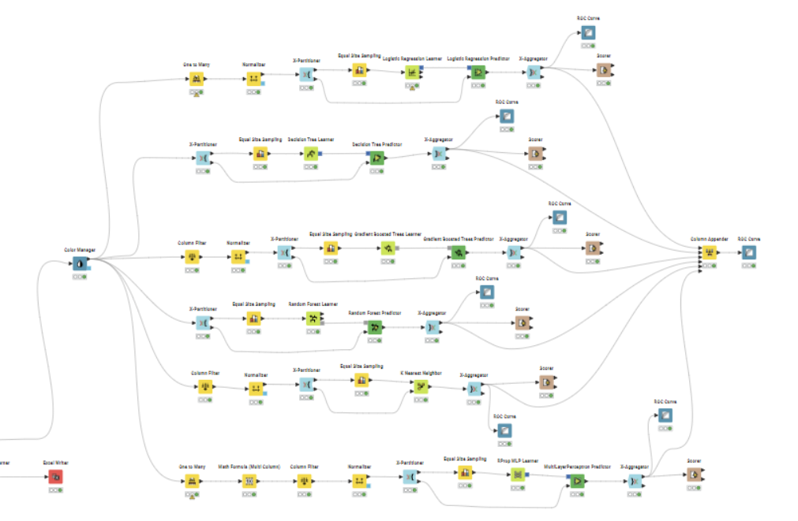
MODELING WORKFLOW
Developed and compared machine learning models to predict injury severity.

Slide 19
Model Performance Comparison
Model | Accuracy | Sensitivity | Specificity | AUC
Logistic Regression | 0.727 | 0.685 | 0.737 | 0.783
Decision Tree | 0.629 | 0.612 | 0.633 | 0.630
Gradient Boosted Trees | 0.726 | 0.702 | 0.731 | 0.791
Random Forest | 0.735 | 0.659 | 0.753 | 0.780
K-Nearest Neighbour | 0.594 | 0.603 | 0.591 | 0.633
Multi-Layer Perceptron | 0.713 | 0.686 | 0.72 | 0.775
Gradient Boosted Trees achieved the highest AUC (0.791), with Random Forest close behind (0.780) and offering higher specificity.
Decision Tree and KNN performed poorly in comparison. Random Forest was chosen for final deployment for its balance between accuracy and interpretability.

Slide 20
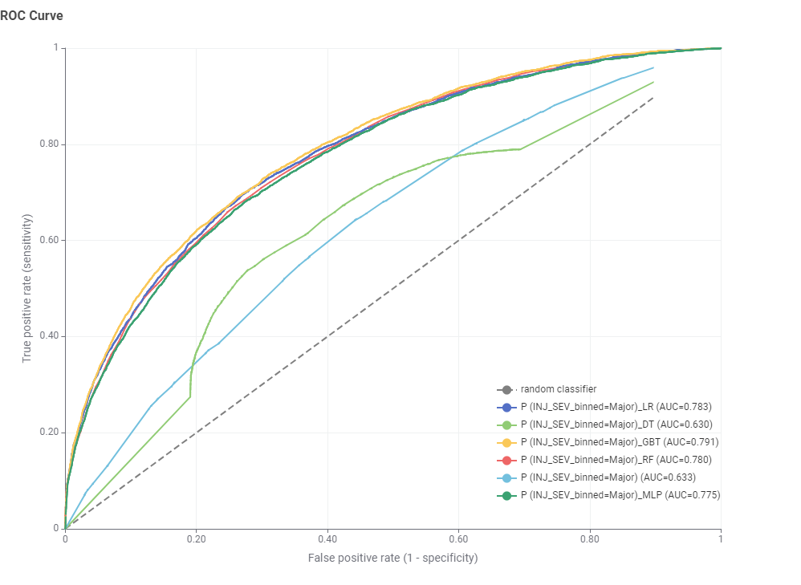
ROC Curve Analysis
Observations:
Gradient Boosted Trees (gold curve) and Random Forest (red curve) show the highest area under the ROC curve, indicating strong classification performance.
Logistic Regression also performed reasonably well.
Decision Tree and KNN had visibly lower ROC curves, reflecting weaker discriminative ability.

Slide 21
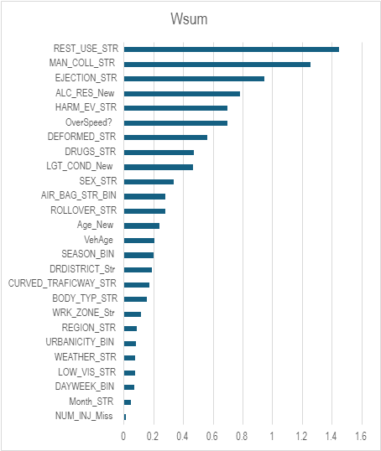
Variable Importance
Top Predictors Identified:
Restraint Use (REST_USE_STR) – strongest predictor
Manner of Collision (MAN_COLL_STR)
Ejection Status (EJECTION_STR)
Alcohol Use (ALC_RES_New)
Harmful Event (HARM_EV_STR)
Over Speeding Indicator (OverSpeed?)
Variable importance graph

Slide 22
Deployment
Selected Model: Random Forest (AUC: 0.780, Accuracy: 73.5%)
Why RF?: Interpretable, fast, and deployment-friendly
Scoring: Weekly KNIME flow auto-scores new crash data
Dashboard: Tableau shows predictions and risk trends
Monitoring: Monthly checks + retraining every 6 months
Handoff Package: KNIME workflow, Tableau file, user guide, report

Slide 23
CONCLUSION
We started by understanding and integrating crash data from multiple CRSS tables. Through careful data cleaning, missing value handling, and feature engineering, we prepared a high-quality dataset suitable for machine learning.
Next, we developed and compared six models, ensuring consistent preprocessing and balanced evaluation. Gradient Boosted Trees achieved the best AUC, while Random Forest was selected for its balance of performance and interpretability.
The final Random Forest model is ready for deployment to predict injury severity. Using these results can benefit real-world traffic safety efforts by enabling better road design, targeted interventions, and proactive crash prevention strategies.

Slide 24

THANK YOU

